Slide 1
Why are microbes important?
Ecological Importance of Microbes
(Applied and Environmental Microbiology Chapter 25)

Slide 2
The majority of microorganisms are beneficial or harmless.
Without bacteria life as we know it would not exist!!
Nitrogen fixation
Carbon cycle
Sulfur and phosphorus cycling

Slide 3
Environmental Microbiology
Microbial Ecology
Study of the interrelationships among microorganisms and the environment
Role of adaptation in microbial survival
Notes:
3

Slide 4
Environmental Microbiology
Microbial Ecology
Role of adaptation in microbial survival
Most microorganisms live in harsh environments
Microbes must be specially adapted to survive
Microbes must adapt to constantly varying conditions
Notes:
4

Slide 5
Applied Environmental Microbiology
Takes advantage of microbial adaptation
Most known application is use of bacteria to clean oil spills
Notes:
5

Slide 6
Industrial Microbiology
Two Types of Bioremediation
Microbes “encouraged” to degrade toxic substances in soil or water
________________________________microbe growth
Genetically modified microbes degrade specific pollutants
Notes:
6

Slide 7
Pollutants
Source: domestic and industrial waste
Dumped into the environment due to convenience or accidental
Dow: Dioxin
Exon & BP oil spills
Synthetic compounds with similar chemical composition and structure are more likely to be degraded
__________________are synthetic compounds totally different than what occur in nature
These often persist in nature for long periods of time
Since organisms are not likely to have enzymes necessary for degrading these

Slide 9
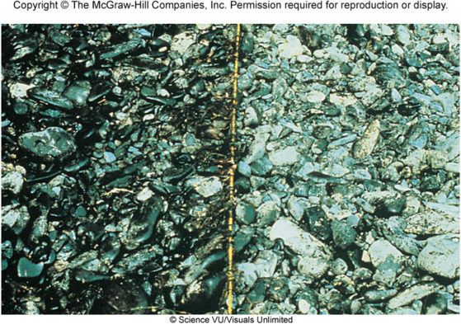

Slide 10
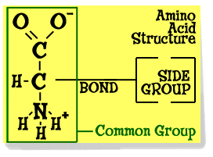
The Carbon Cycle What is one of the main goals of an organism?
In order to ___________most organisms need to _______________________
Carbon
The fundamental element of all organic chemicals
Which we are largely composed of and utilize for energy

Slide 11
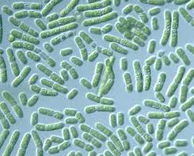
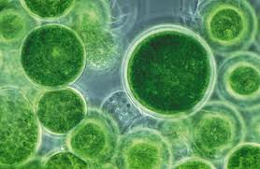
The start of the carbon cycle is autotrophy
Organisms are categorized according to trophic level
Or source of food
Primary producers
Cyanobacteria are prokaryotic autotrophs
Algae and plants are eukaryotic autotrophs

Slide 12
Carbon cycle continued
Utilize organic materials
Release CO2 as a by product
Incorporate organic carbon made by autotrophs into tissues, most of carbon remains in us until we die
Rely on the activities of primary producers
Heterotrophs that digest and utilize the carbon in the remains of primary producers and consumers when we die
Bacteria and fungi play the major role in decomposition
Release CO2 as a by product

Slide 13
What would happen if we did not have decomposers?

Slide 14
Carbon cycle continued
The release of CO2 starts the cycle over again
Worldwide the rate of CO2 production exceeds the rate at which it is being incorporated into organic materials
Why?

Slide 15
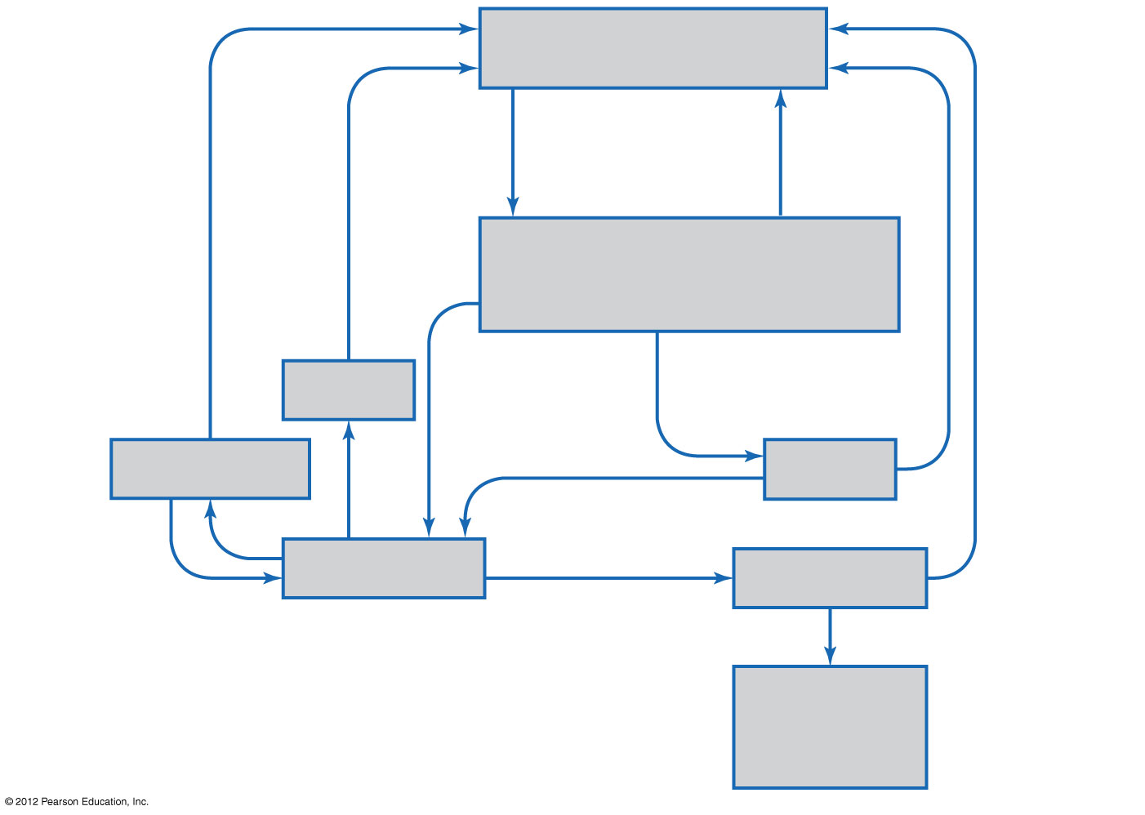
Figure 25.15 Simplified carbon cycle
Atmospheric CO₂ and CO₂ dissolved in water
Decomposition
Fixation (into organic carbon)
Respiration
Combustion
Autotrophs (plants, algae, photosynthetic bacteria, protozoa, chemoautotrophic bacteria)
Methane
Consumption
Fungi, bacteria
Animals
Dead organisms
Fossil fuels
Plastics and other artificial products

Slide 16
Cellulose degradation Microorganisms and herbivores
Cattle eat grasses
Require special microbes capable of digesting cellulose
Specialized digestive compartment
Rumen in cattle
Each milliliter of rumen content contains one hundred billion (10¹¹ or 100,000,000,000) bacteria, 10⁶ protozoa, 10³ fungi
Gases are produced (CO2 and CH4) as a result of fermentation which is discharged when the animal belches
These gases are contributing to the accumulation of green house gases!

Slide 17
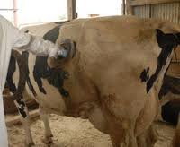

Slide 18
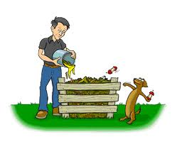
Biodegradation Microbiology in your backyard: composting
Natural decomposition of organic solid material
Mixing garden debris and kitchen organic waste
Must exclude meats and fats
Carbon/nitrogen ratio
Browns = carbon =2/3
Greens = nitrogen= 1/3
Microbial metabolism causes the pile to heat up to 55-66 degrees C
Pathogens are killed at these temperatures
If the pile is frequently aerated the composting can be completed in 6 weeks
Compost is used as fertilizer, reduces landfill waste

Slide 19
Nitrogen cycle
Nitrogen is an important nutritional element required by organisms
Most nitrogen is found as __________
________________by organisms

Slide 20
How do plants and animals get nitrogen?
Since N2 gas is not a usable form of nitrogen consumers (us) must ___________________ ___________ to gain nitrogen.

Slide 21
Nitrogen Fixation
Certain prokaryotic organisms are capable of converting N2 gas into a usable form
Only prokaryotic organisms can do this
During nitrogen fixation
Process in which nitrogen gas N2 is reduced to form ammonia NH3
Ammonia can be incorporated into cellular material
Mediated by the enzyme nitrogenase
Requires 16 molecules of ATP for every molecule of nitrogen fixed

Slide 22
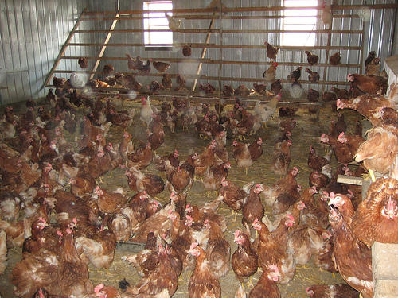
Ammonification
Bacteria (not capable of N fixation) and fungi decompose wastes and dead organisms use the process of ammonification to obtain N
Ammonification
Decomposition process that coverts organic nitrogen (amino groups from proteins) into ammonia NH3
In moist environments ammonium NH4+ is formed, which organisms can also absorb
Protein digestion
NH3
ammonia

Slide 23
Nitrification
Nitrifiers
Oxidize ammonium (NH4+) to nitrite NO2- and ultimately to nitrate NO3-
Plants use Nitrate as a nutrient for growth

Slide 24
Denitrification
Denitrification
Converts nitrate NO3- → nitrite NO2 → N2 or N2O gas
Some Pseudomonas species are capable of doing this.
This is an anaerobic (no oxygen) process

Slide 25
